Slide 1
Proj-Menza-9C
bemutatása

Slide 2
Tartalom
01
02
03
Téma bemutatása
Alkalmazott technológiák
Kígyós Játék
04
05
06
Ebéd Játék
Quiz
Github

Slide 3



Technnológiák
01
02
03
Javascript
Bootstrap
CSS

Slide 4



Technnológiák
04
05
06
Github
HTML
Tiled

Slide 5
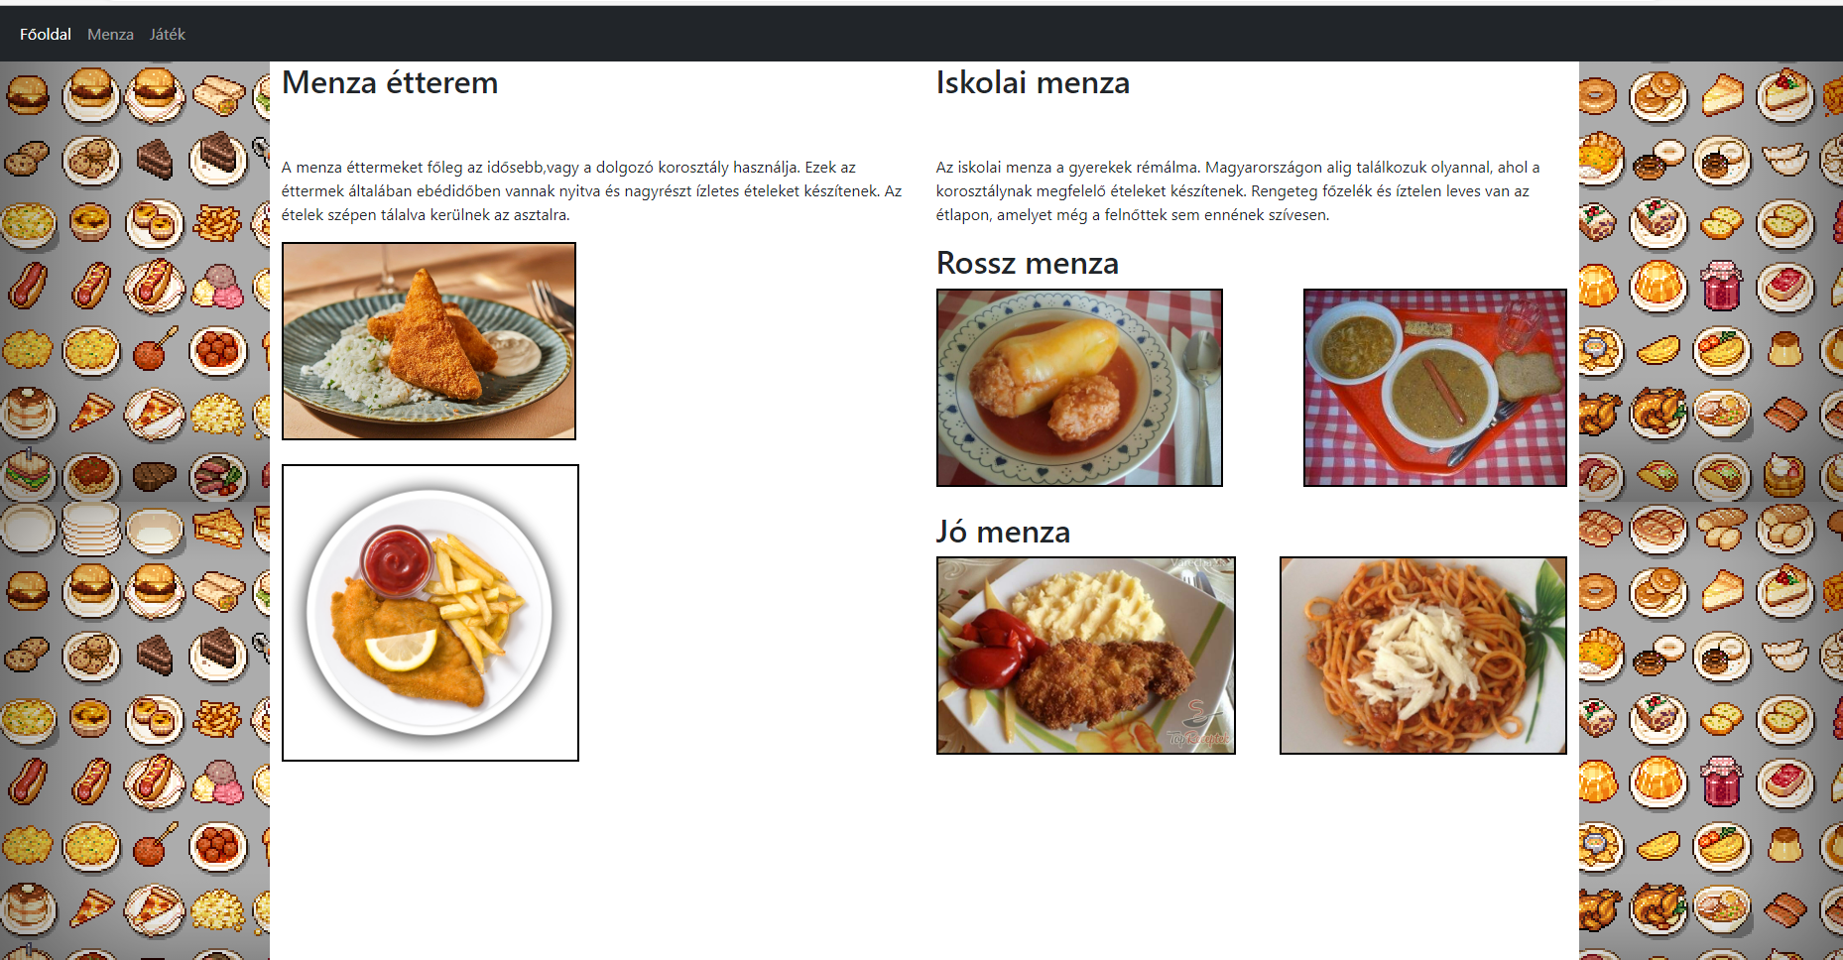
A menza oldal
Bootstrap
HTML
CSS

Slide 6
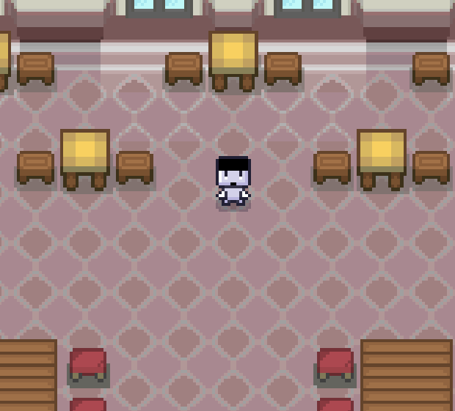
Ebéd játék
Kinézete
Megvalósítása

Slide 7
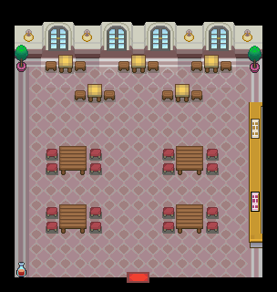
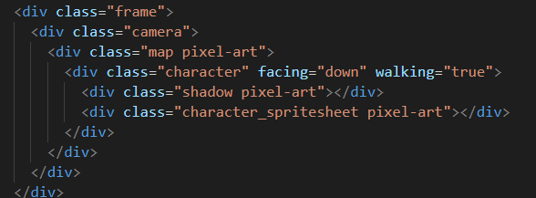
Mozgás alapja

Slide 8
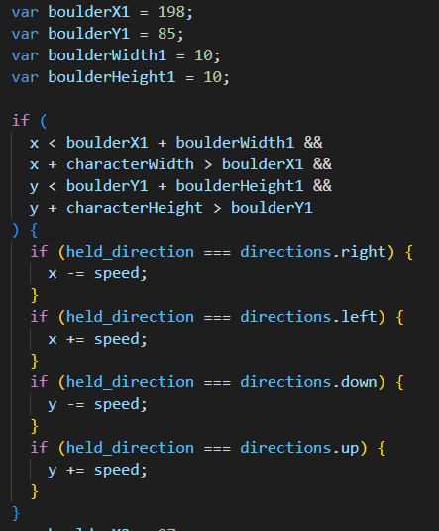
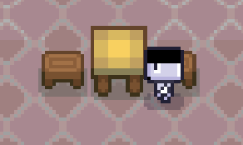
Objektumok

Slide 9
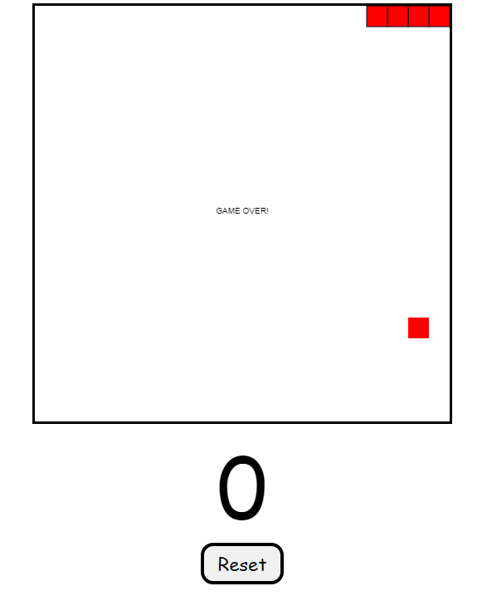
Kígyós játék
Kinézete
Megvalósítása

Slide 10
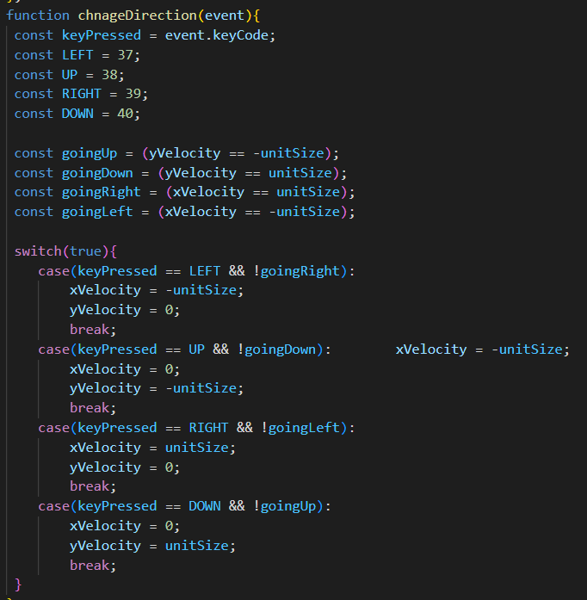
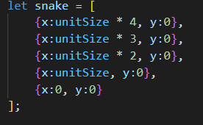
Mozgás és maga a kígyó

Slide 11
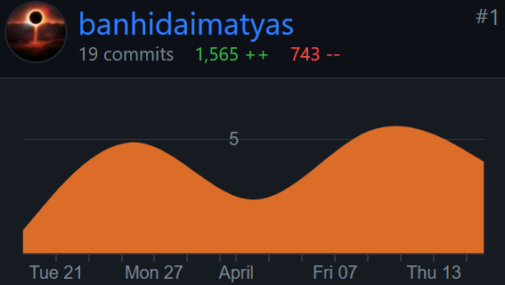
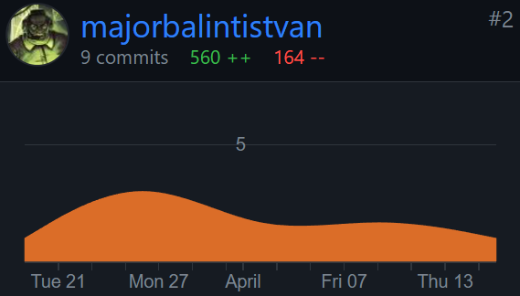
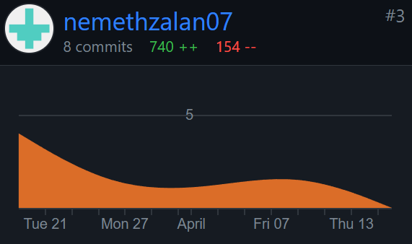
Munkamegosztás
Add a main point
Add a main point
Add a main point

Slide 12
Munkamegosztás#2

Slide 13
Köszönjük a figyelmet!
Készítette: Németh Zalán, Bánhidai Mátyás, Major Bálint

Slide 14
How to Use This Presentation
Google Slides
PowerPoint
Canva
Click on the "Google Slides" button below this presentation preview.
Click on "Make a copy."
Start editing your presentation.
You need to sign in to your Google account.
Click on the "PowerPoint" button below this presentation preview.
Start editing your presentation.
Download and install the fonts used in this presentation as listed on the next page.
Click on the "Canva" button under this presentation preview.
Start editing your presentation.
You need to sign in to your Canva account.

Slide 15

Announcement
I'm Rain, and I'll be sharing with you my beautiful ideas.
Follow me at @reallygreatsite to learn more.

Slide 16

Add an Agenda Page
Write an agenda here.
Write an agenda here.
Write an agenda here.
Write an agenda here.
Write an agenda here.

Slide 17
In dept
Add a main point
Add a main point
Add a main point
Elaborate on a personal detail you want
to share
Elaborate on a personal detail you want
to share
Elaborate on a personal detail you want
to share

Slide 18



Announcements
01
02
03
Amazing announcement for an upcoming event?
Amazing announcement for an upcoming event?
Amazing announcement for an upcoming event?

Slide 19
Key features
Add a main point
What do you do during your free time? Write them here!
Add a main point
What do you do during your free time? Write them here!
Add a main point
What do you do during your free time? Write them here!
Add a main point
What do you do during your free time? Write them here!
Add a main point
What do you do during your free time? Write them here!
Add a main point
What do you do during your free time? Write them here!

Slide 20

Big launches
Elaborate your ideas

Slide 21



Awesome launch
What can you say about these new changes?
Share it here!

Slide 22

Big news!

Slide 23
Write an original statement or inspiring quote
— Include a credit, citation, or supporting message

Slide 24
Write your topic or idea
Add a main point
Add a main point
Add a main point
Elaborate on what you want to discuss.
Elaborate on what you want to discuss.
Elaborate on what you want to discuss.

Slide 25
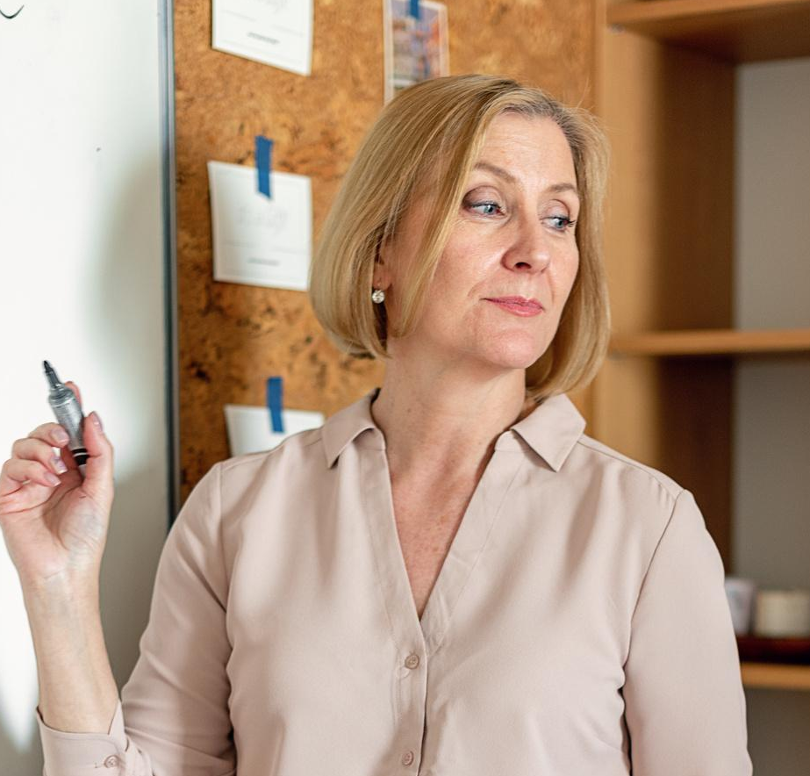


Add a Section Header

Slide 26
2 out
of 5
12
million
95%
Elaborate on the
featured statistic.
Elaborate on the
featured statistic.
Elaborate on the
featured statistic.

Slide 27




Add a Team Member Page
Name
Name
Title or Position
Title or Position
Name
Name
Title or Position
Title or Position

Slide 28
7000,000
Elaborate on the featured statistic

Slide 29
Add a Timeline Page
Add a main point
Add a main point
Elaborate on what you want to discuss.
Elaborate on what you want to discuss.
Add a main point
Add a main point
Elaborate on what you want to discuss.
Elaborate on what you want to discuss.

Slide 30
Add a Roadmap Page
Elaborate on the data you want to discuss
YEAR | JAN | FEB | MAR | APRIL | MAY | JUNE | JULY | AUG | SEPT | OCT | NOV | DEC
Action Point
Action Point
Action Point
Action Point

Slide 31
S
W
STRENGTHS
WEAKNESSES
What are you doing well?
What sets you apart?
What are your good qualities?
Where do you need to improve?
Are resources adequate? What do others
do better than you?
O
T
OPPORTUNITIES
THREATS
What are your goals?
Are demands shifting?
How can it be improved?
What are the blockers you're facing?
What are factors outside
of your control?

Slide 32
Write Your
Topic or Idea
50
40
30
Elaborate on what you want to discuss.
20
10
0
Item 1
Item 2
Item 3
Item 4
Item 5

Slide 33







Add a Chart Page
Name
Job Title
Name
Job Title
Name
Job Title
Name
Job Title
Name
Job Title
Name
Job Title
Name
Job Title
Name
Job Title

Slide 34

Credits
This presentation template is free for everyone to use thanks to the following:
SlidesCarnival for the presentation template
Pexels for the photos
Happy designing!

Slide 35

Fonts In this
Presentation
This presentation template
uses the following free fonts:
Titles: Alice
Headers: Open sauce
Body Copy: Open sauce
You can find these fonts
online too.
Happy designing!

Slide 36
Resource
Page
Use these design resources in your Canva Presentation. Happy designing!
Don't forget to delete this page before presenting.

Slide 37
Resource
Page
Use these design resources in your Canva Presentation. Happy designing!
Don't forget to delete this page before presenting.

Slide 38

Free templates for all your presentation needs
For PowerPoint, Google Slides, and Canva
100% free for personal or commercial use
Ready to use, professional, and customizable
Blow your audience away with attractive visuals

